Slide 1
Ultimate Guide to Upgrade your Umbraco v7 and v8 Projects to v11
Nurhak Kaya

Slide 2
Agenda
Introduction
Is it time for Umbraco upgrades?
What upgrade options are there?
Upgrade steps
Final notes and future Umbraco upgrades
Q&A

Slide 3
Introduction
Hi! My name is Nurhak Kaya.
I’m a Technical Architect at Great State in Bristol, UK.
I’m an Umbraco Certified Master and an Umbraco MVP. I’m also a member of the Umbraco Community Team.
I’ve been working with Umbraco since 2014. I have had a chance to work with various versions of Umbraco (v4, v6, v7, v8, v9, v10 and v11).
I contribute to Umbraco CMS in multiple ways, e.g., blogs, answering questions on Umbraco forum or StackOverflow, organising events, attending events as a speaker, PRs etc.

Slide 4
Is it time for Umbraco upgrades?

Slide 5
Absolutely yes!
This is not an upgrade, but a fresh start!
v7 is fast approaching its End of Life in September 2023
v8 is entering its security-only phase in February 2024
No new features for v8
No more v8 releases after February 2025
v9 was released in September 2021
Latest version of Umbraco is v11.1.0 that is running on .NET 7

Slide 6

Why was the .NET (Core) move so important?
There were many reasons that one could say about moving a .NET Framework project to .NET (Core), but the most obvious reason was that Microsoft stopped working on the older technology of .NET Framework.
This meant that an Umbraco upgrade to .NET was absolutely necessary.
Umbraco HQ got together with the Umbraco Community to move the code base to .NET.

Slide 7
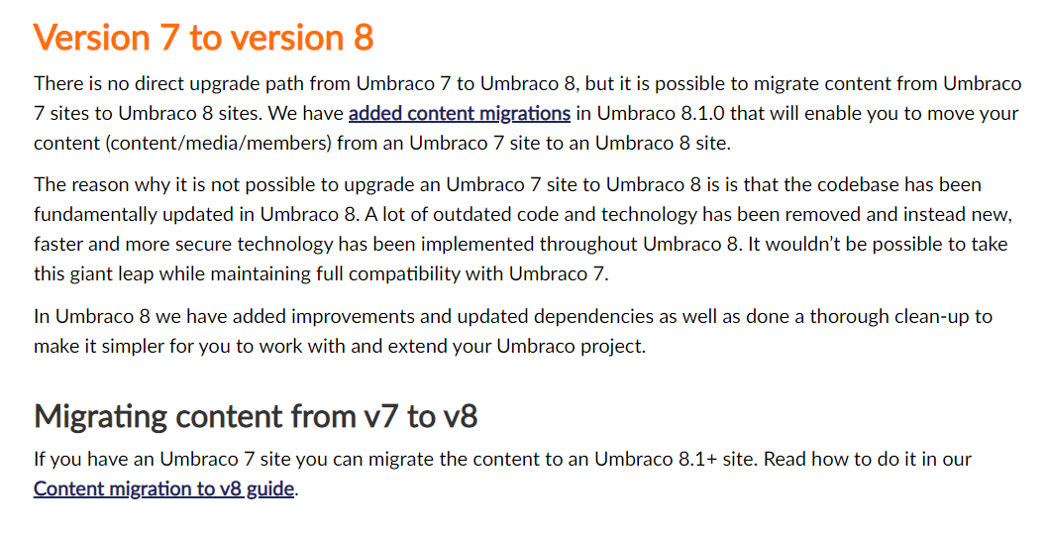
What has changed from v7 to v8?
A lot of old and legacy code was removed while new APIs and features were introduced.
This created a lot of breaking code changes between v7 and v8 which made upgrades from v7 to v8 practically imposible.
What was allowed was to migrate the content and media.

Slide 8
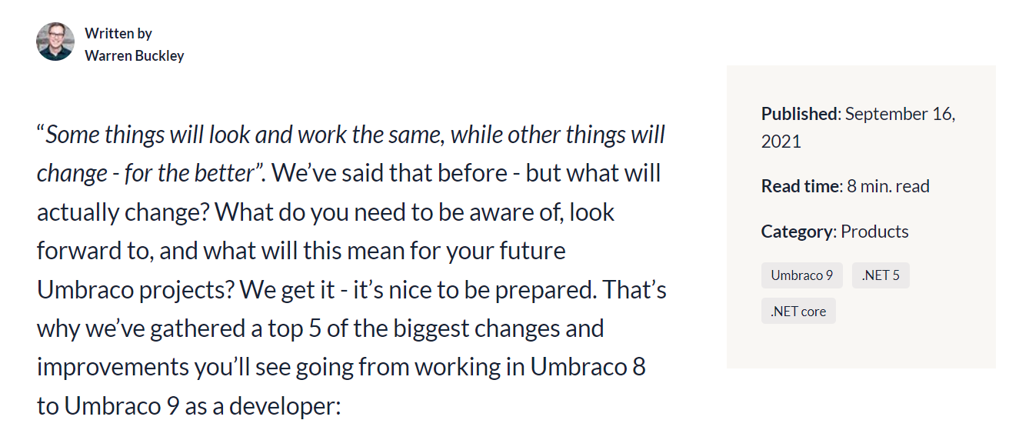
What has changed from v8 to v9?
Briefly put, the main changes were to move the Umbraco codebase from .NET Framework to .NET, without introducing any new features.
Once the first v9 version was ready, then the new Umbraco and .NET features followed.
With the Umbraco .NET move complete, Umbraco CMS is now more future-proof and has much better performance as well as the support of latest security improvements and features of .NET.

Slide 9
What upgrade options are there?

Slide 10
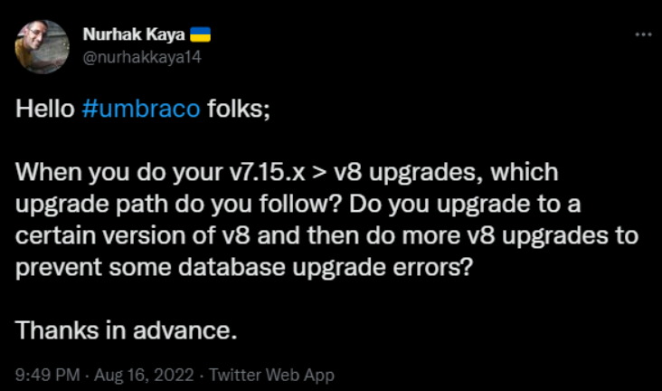
There is no direct upgrade path from v7 to v8, but content migration is possible
If you have a lot of custom code, it could be better to spin up a new Umbraco v11 website, create your Umbraco objects and then write some scripts to do your content migration.
Another approach could be using some 3rd party sofware, so that you could push all your existing content changes into there and then get your content directly from this software for your v11 website (after doing some data transformations).
Final approach is to spin up new Umbraco websites, migrate the content and migrate the custom code. This is what I will continue to talk about.

Slide 11
12 upgrade steps

Slide 12

Step 1–Create back-ups!
It is always a good habit to create backups for your source code and database before and after each step. This is big and things can always go wrong!

Slide 13
Step 2–Make sure your v7 version is min v7.14.0
If not, then upgrade your v7 project to min v7.14.0.
It is best to upgrade your v7 project to the latest version of v7.

Slide 14
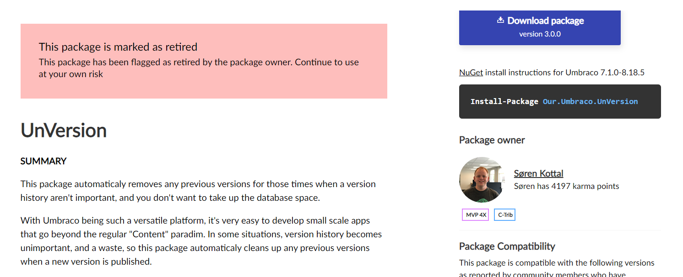
Step 3–Clean up all the things that you won’t need
If you don’t need some of your data, then delete it.
Empty your Umbraco project’s recycle bin.
Clean up your database version history. You can use the UnVersion package or run your own SQL script to do this.

Slide 15
Step 4–Run pre-migration health checks
Use the Pre-migration health checks package for this.
This package will help you idendify some problems which may prevent the database from being migrated to v8. If there are any problems, fix them before jumping to the next step.
At this point, look at this great blogpost by ProWorks so that you won’t miss the important details about Umbraco version thresholds.
Also, take a look at the new uSync Migrations tool as well as some other approaches, like Moriyama’s approach or Enterspeed’s integration apps.

Slide 16
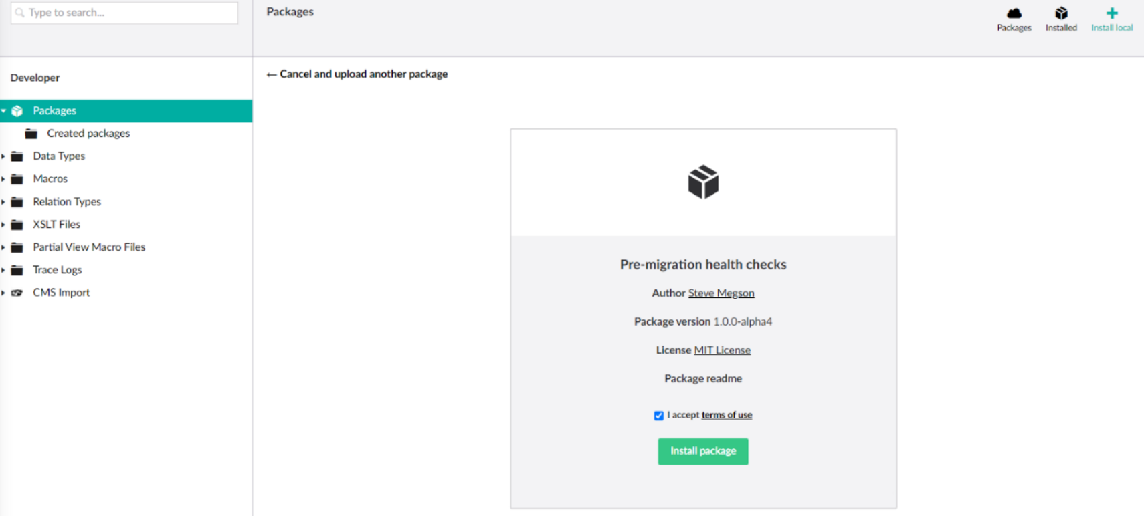
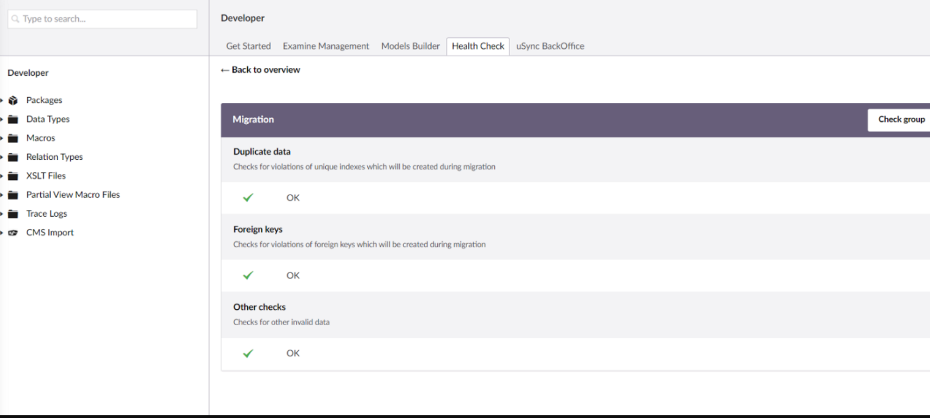
Step 4–Run pre-migration health checks
You can use the Package section in Umbraco backoffice to manually install the Pre-migration health checks package using its zip file.

Slide 17
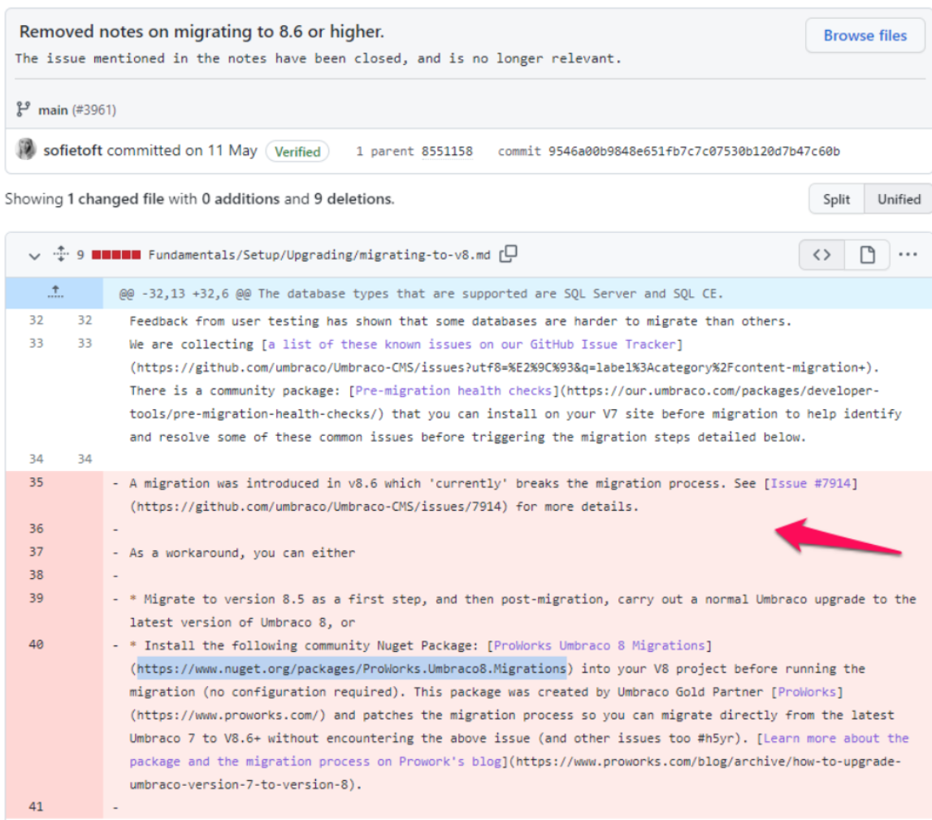
Step 5–Spin up a new v8.5.5 website
It is important to sping up a new v8.5.5 website first as v8.6 has some migration changes that break the v7 to v8 migration.
You can try to go for a higher v8 version using ProWorks.Umbraco8.Migrations package. In any case, make sure that you can login to Umbraco backoffice and do not create any Umbraco objects, yet.

Slide 18
Step 6–Update the v8 web.config file for the connection string and Umbraco version number
Replace your v8 website’s connection string with the v7 connection string. Also, update the Umbraco version from 8.5.5 to your v7 website’s version number.
Umbraco.Core.ConfigurationStatus is where you’ll find your Umbraco version number.
These changes will trigger the content migration when you run your v8 project.

Slide 19
Step 7–Build and run the v8 project and complete the database upgrade as well as the content migration
It is time to build and run your project. I recommend running it without debugging.
After running your project, you should see the Umbraco installer screen which should upgrade your database and files. This should also do the content migration.
Depending on the complexity of your project, you might see some problems. There are quite a few answers on Umbraco Forum and StackOverflow, hopefully, some answers would help you.
If all has been good, then you should be able to login to your new v8 website’s Umbraco backoffice. If you end up seeing more and more problems, you might want to consider a different approach for your upgrade.

Slide 20


Step 8–Upgrade your v8.5.5 project to the latest version of v8
If you have reached this point, then you should make yourself a nice cup of cofee (or something stronger) and enjoy it because you have just completed the trickiest bit of your upgrade.
Upgrade your v8 project to the latest version of v8 and get ready to move your project to .NET 6 and v10!

Slide 21
Step 9–Spin up a new .NET 6 v10.0.1 Umbraco website
Spin up a new v10.0.1 website and complete your database installation without creating any Umbraco objects.
Make sure you can login to the Umbraco backoffice and check that things are good.
For step 9, you can potentially use the latest version of v10, but it is generally a good idea to be as close as possible to v9, hence this version.

Slide 22
Step 10–Update your appsettings.json file and start using the v8 connection string for your v10 project
There is no way to directly upgrade your v8 website to v10. This is due to v8 running on .NET Framework and v10 running on .NET 6, but you can once more migrate your content.
After updating the v10 project’s connection string to use the v8 project’s connection string, run your v10 project – this will trigger the database upgrade and the content migration.
As the v8 database schema is very similar to the v10 database schema, things should easily be upgraded and migrated at this point.
Once all is done, login to your v10 website’s Umbraco backoffice and check your content.

Slide 23
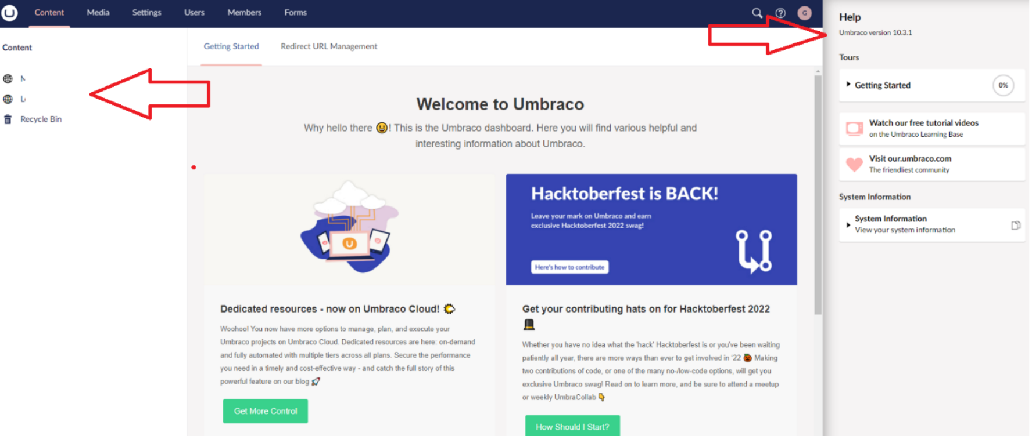
Step 11–Upgrade your v10.0.1 project to the latest version of v10 and then v11
It is time to upgrade your v10 project to the latest version of v10 using the Package Manager Console (or whatever you are using).
Once the v10 upgrade is complete, then upgrade your project to .NET 7 and the latest version of Umbraco v11.
Make sure that all is still good after your latest upgrade is complete.

Slide 24

Step 12–Create your custom code
This is the final step of your upgrade. You can now create yoıur custom changes for your brand-new v11 website and create new Umbraco objects or update them or do other things that you might need to do like creating templates etc.

Slide 25
Final notes and future Umbraco upgrades

Slide 26
Final notes and future Umbraco upgrades
Change is inevitable and will continue to happen and it is important to adapt(and upgrade your projects) at the right time with the right tools.
Depending on the complexitiy of your projects, you might have some additional steps, and if you do, please remember to share your knowledge with the rest of the friendly Umbraco community.
With regards to the future Umbraco upgrades; Umbraco have started to release a new minor CMS version every 6 weeks and a new major version every 6 months. You should keep an eye on the Umbraco release schedule and continuously do your Umbraco upgrades.
For more details, you can check my skrift.io article.

Slide 27



Thank you for joining me today! #h5yr Any questions?
Nurhak Kaya
:https://twitter.com/nurhakkaya14
:https://www.linkedin.com/in/nurhak-kaya-53825051/
https://github.com/NurhakKaya

